Slide 1



Slide 2

Library book management system
“A c language file-handling based project”
Team Details-
Parna Jayavardhan(team leader)
Basa kavya sri
Jami Manoja
Karra Jaya Surya
Patta Charan Satyananda Vivek Varma

Slide 3

contents/Index-
1.Abstract
2.Introduction
3.Applications
4.Existing methodology
5.Drawbacks
6.Proposed methodology
7.Advantages
8.Architecture
9.Results
10.conclusion

Slide 4

Abstract-
The Library Book Management System is a digital solution designed to automate and simplify library operations..
It replaces manual record-keeping with an organized system that manages books, members, and issue/return transactions efficiently.
The project improves accuracy, saves time, and ensures quick access to information through a structured database and user-friendly interface.
Overall, it enhances library productivity and provides a reliable platform for smooth and effective library management.

Slide 5

Introduction-
Library systems are needed to organize books and members, track issues/returns efficiently, reduce errors, and save time.
Manual record keeping is slow, error-prone, and hard to manage, while automated systems are fast, accurate, and easy to maintain.
Reducing errors and saving time improves efficiency, ensures accurate records, and makes library operations faster and more reliable.
Our Library Book Management System reduces errors and saves time by automating book and member records, making library operations fast, accurate, and efficient.

Slide 6

Applications-s
Book Management – Add, update, and delete book records.
Member Management – Register and manage library members.
Issue & Return Tracking – Efficiently handle borrowing and returning of books.
Search Functionality – Quickly find books by title, author, or category.
Overdue & Fine Management – Track late returns and calculate fines.
Report Generation – Generate reports on books, members, and transactions.
Digital Record Keeping – Maintain accurate and organized library records.

Slide 7
Existing Methodology-
Current/old library systems rely on manual record-keeping, making book management slow, error-prone, and inefficient.
In the old system, libraries used manual register books to record all transactions, which was time-consuming and prone to errors.
Manual record-keeping in libraries has higher chances of data loss due to damage, misplacement, or human error.
Manual searching of books and member records is time-consuming and inefficient.

Slide 8

Drawbacks of existing methodology-
No real-time stock updates.
Everything is written manually in registers.
Searching for a book takes more time.
More chances of mistakes by humans.
Hard to track who took which book.
Cannot know book availability quickly..
Old records are difficult to maintain.
Paper registers can get damaged or lost.
Not suitable when the number of books increases.

Slide 9

Proposed methodology-
The system uses a C program to manage all library operations automatically.
All book and student details are stored safely in files instead of paper registers.
The system performs automated operations like adding books, issuing books, returning books, and displaying records.
Books can be tracked easily using the book name and student roll number, making searching fast..
The system helps in easy stock management, showing available books, issued books, and total books instantly...

Slide 10
Advantages-
Faster and easier operations like issuing, returning, and searching books.
Accurate and error-free record keeping due to automated C program.
Safe data storage using files, so no information is lost.
Quick tracking of books using book name and student roll number.
Easy stock management showing available, issued, and total books instantly.
Reduces manual work and saves time for both librarian and students.

Slide 11
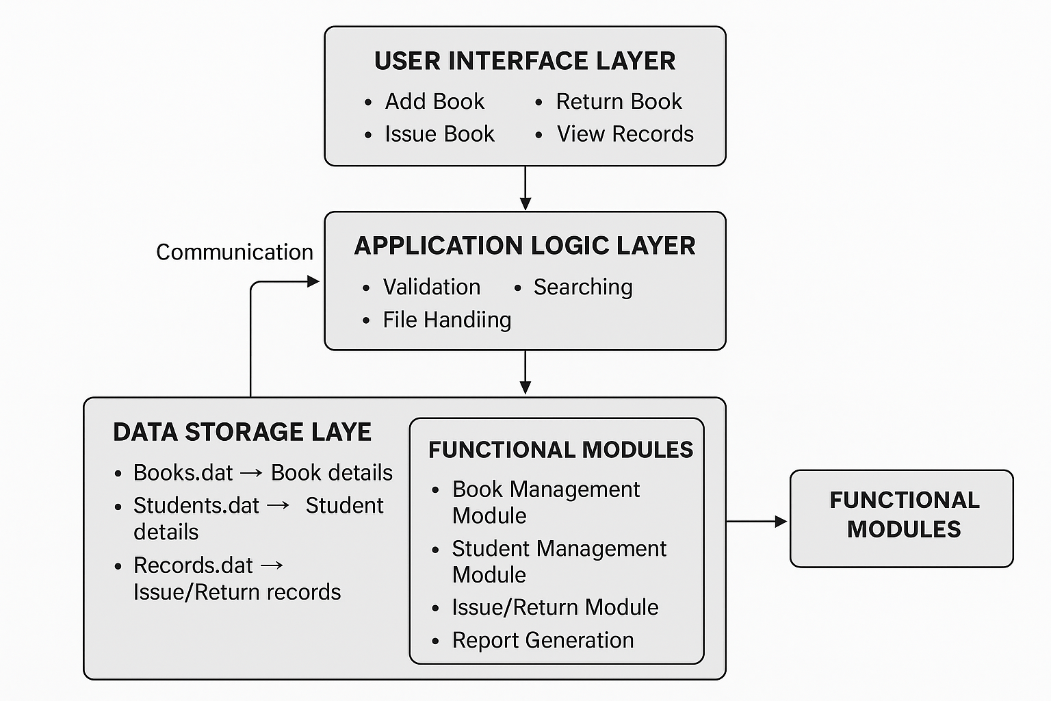
Architecture diagram-
Architecture diagram-

Slide 12
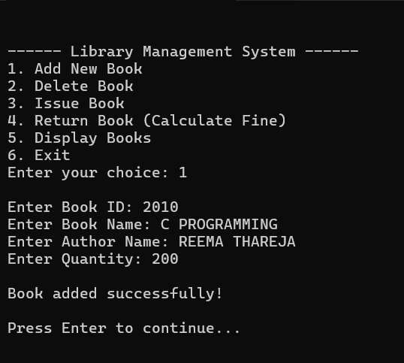
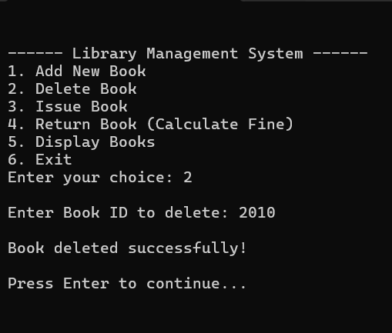
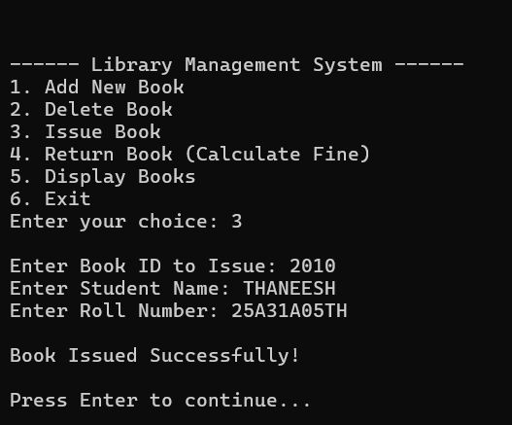
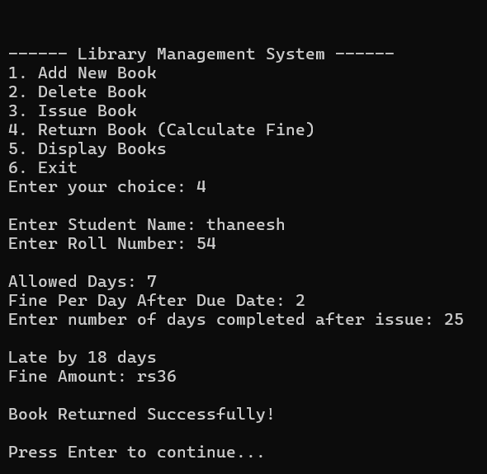
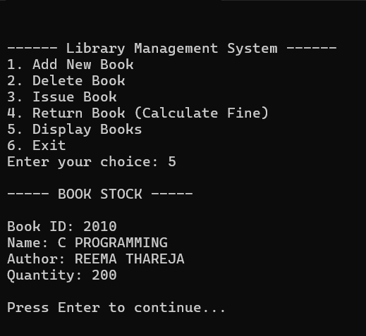

Slide 13
Conclusion-
The Library Book Management System successfully replaces the traditional manual process with a faster, more accurate, and fully automated solution. By using a C program with file handling, the system efficiently manages book records, tracks issued and returned books, and maintains updated stock information. It reduces human errors, saves time, improves data security, and makes the entire library operation more organized and reliable. Overall, this system provides a simple yet powerful platform for smooth library management.

Slide 14


THANK YOU
“Any Questions”?

